Slide 1

Advisify – AI Course Advisor An Intelligent Solution for Automated Academic Advising
Supervisor: Syed Haider Imam Jaffery

Slide 2
GROUP MEMBERS
ALI RAZA BUGTI (FA22-BSCS-0136)
MUHAMMAD AHMED (FA22-BSCS-0210)
ARFAT AYUB (FA22-BSCS-0138)

Slide 3
Problem Statement
Many students struggle to select suitable courses after F-grades, withdrawals, or semester breaks.
Faculty advisors face heavy workload during registration days.
Manual advising causes errors, delays, and confusion in course planning.
There is no AI-based system to recommend courses based on student history and prerequisites.

Slide 4
Motivation
Every semester, students face stress and confusion during course registration.
Faculty handle large advising loads, leading to long queues and errors.
Manual process wastes time and affects academic planning.
We aim to make advising faster, accurate, and effortless using AI.

Slide 5
Introduction
Academic advising is essential for student success in universities.
The traditional advising process is manual, time-consuming, and error-prone.
Students often struggle to plan courses after failures or academic breaks.
Advisify – AI Course Advisor automates advising using machine learning for smarter, data-driven course selection.

Slide 6
Project Objective(s)
Develop an AI-powered system for course recommendations.
Analyze academic history to suggest the most suitable courses.
Design three main modules:
Student Module – for uploading data and receiving AI recommendations.
Faculty Module – for reviewing and approving student course plans.
Admin Module – for managing users, courses, and AI datasets.
Reduce manual workload and improve the accuracy and speed of the registration process.

Slide 7
Methodology
Collect and clean historical student data.
Train ML model to predict suitable courses.
Build web system using Next.js + FastAPI + PostgreSQL.
Integrate AI with web modules (Student / Faculty / Admin).
Test, evaluate, and refine model recommendations.

Slide 8
Methodology

Slide 9
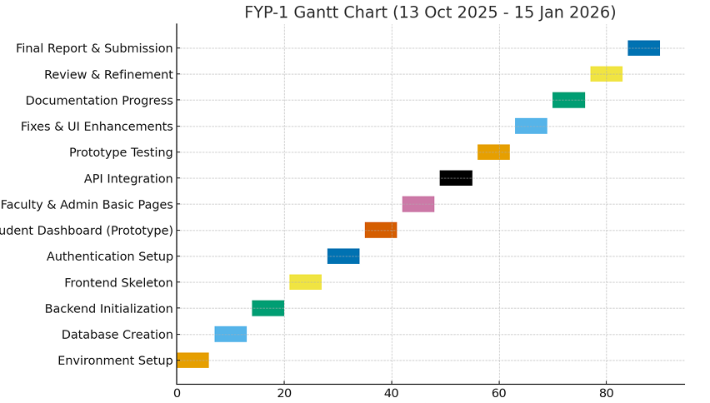
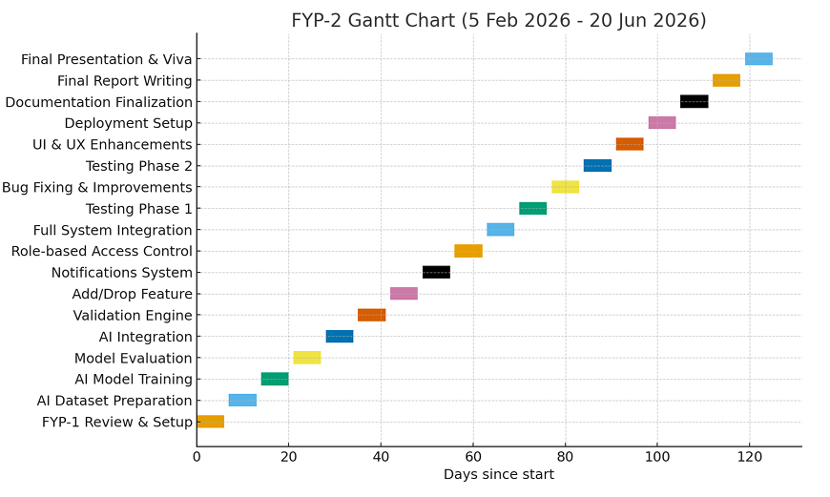
Plan(Work Breakdown Structure)
FYP-1
FYP-2

Slide 10
References
Zafra & Ventura (2019) – Predictive Modeling for Student Performance in Higher Education.
Al-Barrak & Al-Razgan (2020) – Intelligent Recommender System for Academic Advising.
IBM Watson Education (2021) – AI in Learning Analytics.
Coursera (2022) – AI-Based Course Recommendation System.
edX (2022) – Personalized Learning and Course Pathways.
Documentation: Next.js, FastAPI, PostgreSQL

Slide 11
THANK YOU

